Slide 1

Machine Learning Approaches for Cardiovascular Disease Prediction: A Comprehensive Analysis

Slide 2

Group Members
SHIVA PRIYA BURRA
SAHITYA RAVALI KANDUKURI

Slide 3

Roles and Responsibilities
SHIVA PRIYA BURRA: Dataset Collection, Preprocessing, Model
Development
SAHITYA RAVALI KANDUKURI: Feature selection, Model Assessment.

Slide 4
Motivation
This paper examines the potential, limitations, and future research opportunities of machine learning (ML) techniques in cardiovascular disease (CVD) prediction. ML has created new opportunities for proactive disease management and enhanced patient care, such as the detection of arrhythmias, the estimation of coronary heart disease risk, and the identification of pulmonary hypertension. However, it is essential to address the upcoming obstacles such as data diversity, interpretability, and data privacy to pave the way for advances in the prediction and management of cardiovascular disease, improving patient outcomes and reducing the global burden of CVDs.

Slide 5
Objectives
This study looks at artificial neural networks, decision trees, support vector machines, and ensemble methods as machine learning techniques for cardiovascular disease prediction. It also investigates the possibility of machine learning algorithms for pulmonary hypertension prediction, heart rate variability analysis, and arrhythmia detection. It also examines how machine learning algorithms are combined with cutting-edge technologies like deep learning, computer vision, and natural language processing. Finally, it examines the use of powerful ML algorithms and individual-specific data to create customized interventions and treatment programs.

Slide 6

Related Work
A promising technique for improving risk assessment and CVD prognosis is machine learning (ML). Studies have used Deep Learning methods, Ensemble methods, Artificial Neural Networks (ANNs), Decision Trees (DTs), Support Vector Machines (SVMs), and the detection of particular CVDs. Machine learning approaches have been applied to identify morphological and functional markers of CVDs, detect cardiac ischemia, enhance hospital-specific CVD predictions, and extract useful data from medical records. There are still issues to be solved before ML approaches can be utilized to forecast and assess the risk of cardiovascular illnesses. The predictive power of ML can be further increased by combining it with other technologies.

Slide 7

Problem Statement
The context provides information on machine learning techniques for cardiovascular disease prediction and proposes a comprehensive framework to incorporate these methods and technologies. The problem statement is to enhance cardiovascular disease prediction using machine learning techniques by addressing existing obstacles and maximizing the potential of ML techniques. The proposed framework seeks to incorporate multiple data sources, advanced machine learning algorithms, and novel techniques to assure effective patient care strategies.

Slide 8

Proposed Solution
The proposed solution is to enhance cardiovascular disease prediction using machine learning techniques includes multiple data sources, advanced machine learning algorithms, and novel techniques to address existing obstacles and maximize the potential of machine learning in CVD prediction.

Slide 9

Results/Simulations
The code provided trains a Logistic Regression model and a Random Forest model on a synthetic dataset, with similar accuracy scores. The Logistic Regression model has slightly better generalization, while the Random Forest model has a perfect accuracy score.

Slide 10
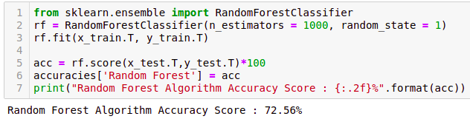
Results/Simulations

Slide 11
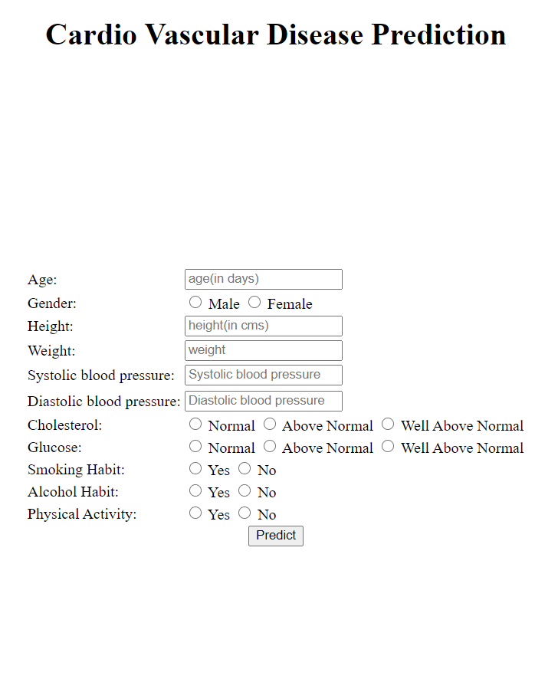
Results/Simulations

Slide 12
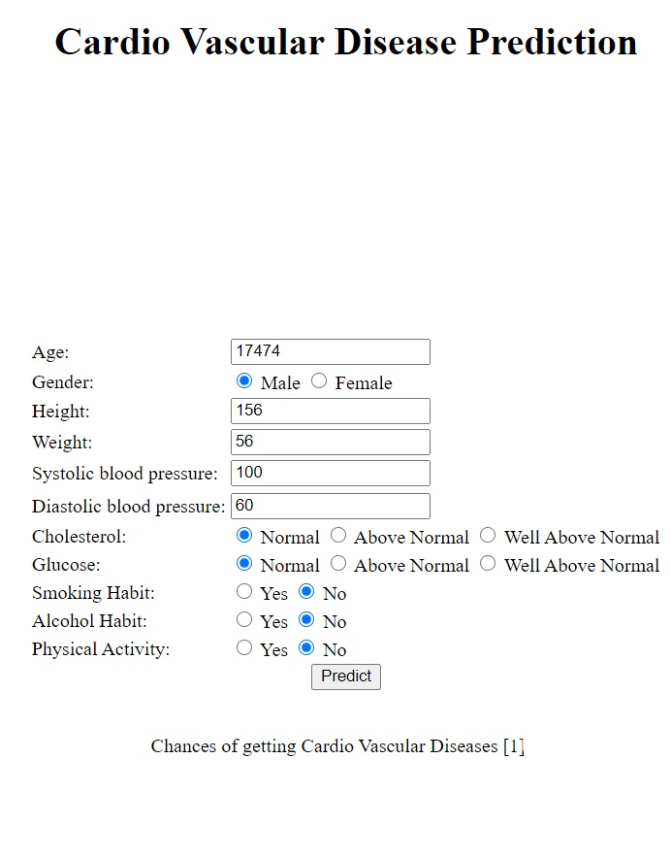
Results/Simulations

Slide 13

Referrences
. S. Chatterjee, et al., "Machine learning-based prediction of heart disease," 2020 International Conference on Computer Science, Engineering and Applications (ICCSEA), 2020.
H. Y. Zheng, et al., "Predictive modeling of cardiovascular diseases: A review of methods, techniques, and applications," 2019 IEEE International Conference on Bioinformatics and Biomedicine (BIBM), 2019
P. R. Patil, et al., "cardiovascular disease prediction using machine learning techniques: A systematic review," 2020 International Conference on Emerging Trends in Information Technology and Engineering (ic-ETITE), 2020.
S. V. S. S. S. Nagabhushana, et al., "A novel approach for predicting cardiovascular disease using data mining techniques," 2017 International Conference on Computer Communication and Informatics (ICCCI), 2017.
N. F. F. Pratiwi, et al., "heart disease prediction using deep learning," 2020 International Electronics Symposium (IES), 2020.
N. G. Aydin, et al., "Machine learning-based prediction of cardiovascular disease using six different cardiovascular risk factors," 2020 28th Signal Processing and Communications Applications Conference (SIU), 2020.
S. K. Singh, et al., "Prediction of cardiovascular disease using machine learning algorithms: A survey," 2020 7th International Conference on Computing for Sustainable Global Development (INDIACom), 2020.
A. Kumar, et al., "Prediction of heart diseases using machine learning algorithms," 2017 International Conference on Computing, Communication and Automation (ICCCA), 2017.
D. Dua, et al., "Machine Learning Techniques for Heart Disease Prediction: A Comparative Study," 2020 10th International Conference on Cloud Computing, Data Science & Engineering (Confluence), 2020.
H. S. Dhaliwal, et al., "Heart disease prediction using machine learning: A comparative analysis," 2020 7th International Conference on Signal Processing and Integrated Networks (SPIN), 2020.

Slide 14
Referrences
A. M. Alghamdi, et al., "Heart disease prediction using machine learning techniques: A survey," 2018 1st International Conference on Computer Applications & Information Security (ICCAIS), 2018.
A. E. Taha, et al., "Machine learning techniques for coronary heart disease prediction," 2018 14th International Computer Engineering Conference (ICENCO), 2018.
R. Detrano, et al., "Artificial neural networks in coronary heart disease risk assessment," 1995 17th Annual International Conference of the IEEE Engineering in Medicine and Biology Society, 1995.
S. S. R. M. B. M. Gowd, et al., "Prediction of cardiovascular risk using supervised machine learning algorithms," 2019 IEEE 9th Annual Computing and Communication Workshop and Conference (CCWC), 2019.
S. R. Safavian, et al., "A comparative study of the use of decision tree and artificial neural network methods for medical diagnosis," 1990 12th Annual International Conference of the IEEE Engineering in Medicine and Biology Society, 1990.
M. G. Tsipouras, et al., "An arrhythmia classification system based on the RR-interval signal," 2005 IEEE Engineering in Medicine and Biology 27th Annual Conference, 2005.
T. Banerjee, et al., "A machine learning approach for the prediction of pulmonary hypertension," 2013 35th Annual International Conference of the IEEE Engineering in Medicine and Biology Society (EMBC), 2013.
P. Melillo, et al., "Stress detection using heart rate variability and a support vector machine classifier," 2011 Annual International Conference of the IEEE Engineering in Medicine and Biology Society, 2011.
J. Wiens, et al., "A Study in Transfer Learning: Leveraging Data from Multiple Hospitals to Enhance Hospital-specific Predictions," 2014 36th Annual International Conference of the IEEE Engineering in Medicine and Biology Society, 2014.
M. Adnane, et al., "Machine learning for cardiac ischemia detection using instantaneous heart rate and instantaneous respiratory rate," 2018 40th Annual International Conference of the IEEE Engineering in Medicine and Biology Society (EMBC), 2018.

